Slide 1
HEBB LEARNING

Slide 2
Historical Context
Humans have long dreamt of building machines which can think and replicate human behavior.
The attempts of understanding how the human mind works can be dated back to Aristotle who gave his theory of Associationism in around 300 BC.
Associationism states that mind is a set of conceptual elements that are organized as associations between these elements.
To an extent, learning is forming Associations.

Slide 3
Human memory associates
Similar items,
Contrary/opposite items,
Items close in proximity,
Items close in succession (e.g., In a song)etc.

Slide 4
Think of BITSIN days- compre, nightouts, surprise tut tests
Think of a Bitsian friend on his/her bday.. All other friends with whom you celebrated such events would come to mind
Also the one who refused to come

Slide 5
Aristotle gave FOUR laws of auto association ( even after so many years still form the basis for machine learning methods).
Contiguity: Things or events with spatial or temporal proximity tend to be associated in the mind
Frequency: The number of occurrences of two events is directly proportional to the strength of association between these two events
Similarity: Thought of one event tends to trigger the thought of similar event
Contrast: Thought of one event tends to trigger the thought of an opposite event

Slide 6
The main property of a neural network is an ability to learn from its environment, and to improve its performance through learning.
In contrast to supervised learning, unsupervised or self-organised learning does not require an external teacher.
During the training session, the neural network receives a number of different input patterns, discovers significant features in these patterns and learns how to classify input data into appropriate categories.

Slide 7
Pattern recognition
What are Patterns??
Images, Personal records, Driving habits, etc.
Represented as a vector of features (encoded as integers or real numbers in NN)
Pattern Classification:
Classify a pattern to one of the given classes
Form pattern classes

Slide 8
Pattern Associative Recall : Using a pattern to recall a related pattern
Pattern completion: using a partial pattern to recall the whole pattern
Pattern recovery: deals with noise, distortion, missing information in given pattern to still recover whole pattern

Slide 9
Pattern Associations
An association is any link between a system’s input and output such that when a pattern A is presented to the system, it will respond with pattern B.
When two patterns are linked by an association, the input pattern is called the stimulus and the output pattern is called the response

Slide 10
Experiments on Behaviorist Psychology
To demonstrate operation of associative learning rules, Ivan Pavlov– Performed an experiment , in which he trained a dog to salivate at the sound of a bell, by ringing the bell whenever the food was presented (an example of classical conditioning)

Slide 11
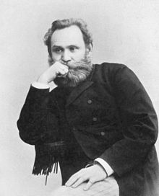
Ivan Pavlov, Russian physiologist
known primarily for his work in classical conditioning
Pavlov won the Nobel Prize for Physiology or Medicine in 1904 becoming the first Russian Nobel laureate.

Slide 12
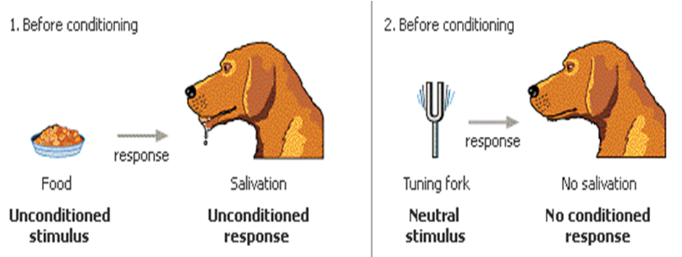
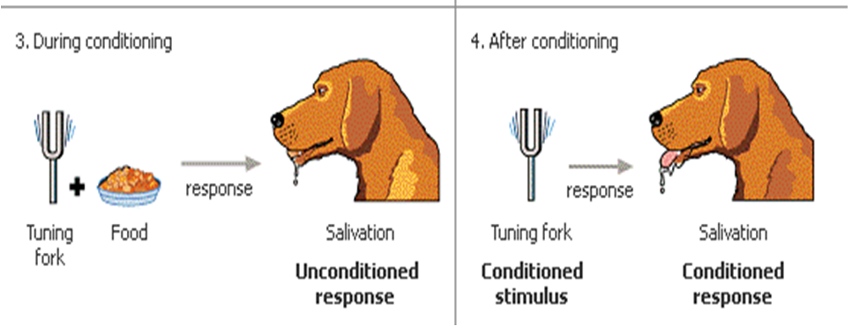

Slide 13
Classical conditioning can be modeled with a Hebbian synapse.
Consider an unconditioned stimulus (food),
an unconditioned response ( salivate),
a conditioned stimulus (bell) and a conditioned response(salivate).

Slide 14
Classical conditioning can be modeled with a Hebbian synapse.
Consider an unconditioned stimulus (an airpuff),
an unconditioned response (eye blink),
a conditioned stimulus (a tone) and a conditioned response(eye blink).

Slide 15
In Hebbian learning, increase weights that produce positive correlations between the inputs and outputs of the network.
The neural substrate’s analog of this is to strengthen synapses that cause the inputs and outputs of the system to spike together – i.e.,
“cells that fire together wire together.”

Slide 16
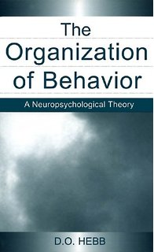
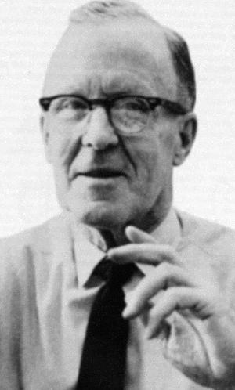
Since its publication in 1949, D.O. Hebb's, The Organization of Behavior has been one of the most influential books in the fields of psychology and neuroscience.
However, the original edition has been unavailable since 1966, ensuring that Hebb's comment that a classic normally means "cited but not read" is true in his case

Slide 17
Hebb’s Law can be represented in the form of two rules:
If two neurons on either side of a connection are activated simultaneously (synchronously) then the weight of that connection is increased.
If two neurons on either side of a connection are activated asynchronously, then the weight of that connection is decreased.
Hebb’s Law provides the basis for learning without a teacher. Learning here is a local phenomenon occurring without feedback from the environment.

Slide 18
Hebb’s rule’s implementation is easy and takes a few number of steps.
The Hebbian algorithm is used in many areas, and especially in speech and image processing

Slide 19
In ANNs, neurons are typically referred to as Processing Elements (PE) to differentiate them from the biological equivalents.

Slide 20
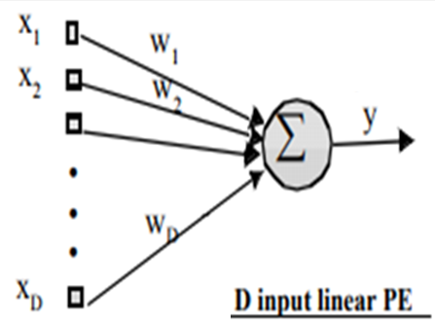
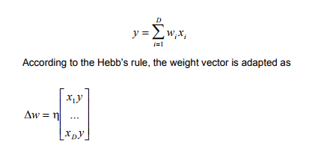

Slide 21
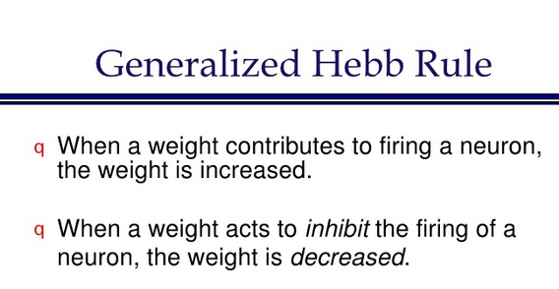
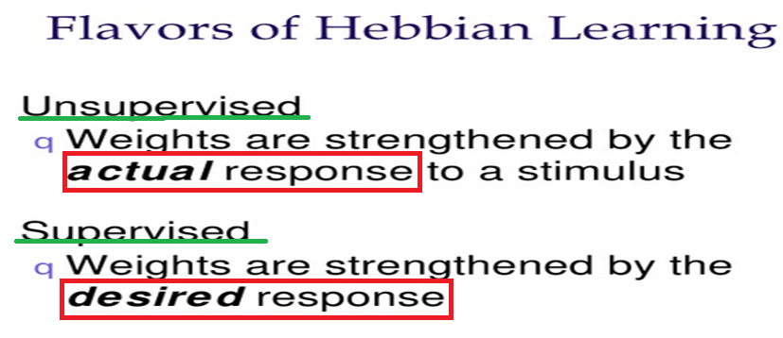

Slide 22
Network for Banana Associator
The Network has both :
Unconditional stimulus (banana shape) and
Conditional stimulus (banana smell).

Slide 23
Unconditional stimulus (shape) is represented as p⁰
Conditional stimulus (smell) is represented as p
Weight (w⁰ )associated with p⁰ is fixed
weight (w )associated with ‘p’ is adjusted according to relevant learning rule
Associate SHAPE of banana , not smell

Slide 24
unconditioned (shape) and conditioned(smell) inputs

Slide 25
Weight w⁰ representing weight for unconditional stimulus p⁰ will remain constant
‘w’ associated with conditional response ‘p’ will be updated at each iteration using unsupervised Hebb Rule with learning rate of 1

Slide 26
The banana associator’s input and output function with initial w=0, simplifies to
Network will respond only if banana is sighted p⁰ =1 whether or not banana is smelled or not p=1 or 0 [w=0]

Slide 27

p=1 ( smell present) will produce the response a=1, regardless of value of p⁰ when w>-0.5 (=b),
The Unsupervised Hebb rule can also be written in vector notation as

Slide 28
The associator would initially respond to the sight and not the smell of the banana
The associator would be repeatedly exposed to the banana.
Assumption : While the network’s smell sensor would operate reliably, the shape sensor would operate only intermittently (even time steps).
The training sequence would contain repetitions of the following two sets of inputs

Slide 29
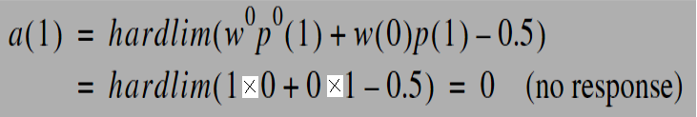
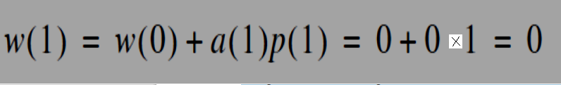
The output for the first iteration :p⁰(1) =0 ,p(1)=1, Smell alone, Sight detector fails
The smell alone did not generate a response.
Without a response the Hebb rule doesn’t alter ‘w’

Slide 30
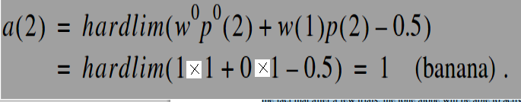

In the second iteration, both the banana’s smell and shape are detected
p⁰ (2) =1 ,p(2) =1
Because the smell stimulus and response have occurred simultaneously, the Hebb rule increases the weight between them

Slide 31
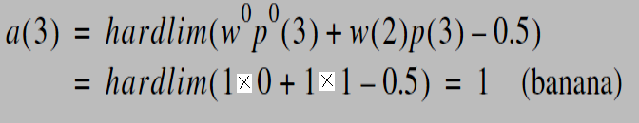

When the sight detector fails again, in the third iteration, the network responds anyway. It has made a useful association between the smell of a banana and its response.
p⁰ (3) =0 ,p(3)=1
From now on the network is capable of responding to bananas that are detected either by sight or smell. Even if the network suffers with intermittent faults,

Slide 32
Shortcomings of Hebb Rule
If we continued to present the inputs and keep updating the weight ‘w’, then ‘w’ will become arbitrarily large, irrespective of the value of η, .
This is at odds with the biological system that inspired the Hebb rule. There are natural limitations to biological synaptic efficacy (chemical depletion, dynamic range, etc).
This is unlike the behavior we observed for backpropragation, where the weights would stabilize for a range of step sizes.
Hence, Hebbian learning is intrinsically unstable, producing very large positive or negative weights.

Slide 33
HEBB RULE WITH DECAY
Rule 1 uses forget factor γ, if this factor is 0.1, learning rate is 1, then when stimulus is absent weight decreases by 10%
While in rule 2 –y(n) w_{i} (n) is reflecting leakage, forgetting, more is the stronger response y(n), more is forgetting
Both result in stabilization of synaptic weight w_{i} (n) as it evolves across time

Slide 34
Every association ( A—B ) is a pair of vectors of an input-output, where A is the input vector, and B is the target vector.
If both the vectors A and B are the same, then we call it an Autoassociative memory neural network.
If the vectors A and B are different, then it is called a Heteroassociative memory neural network.

Slide 35
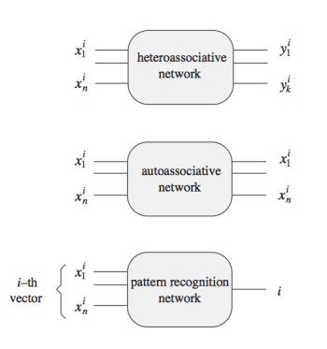

Slide 36
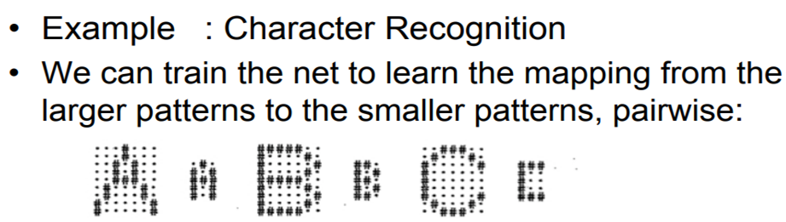
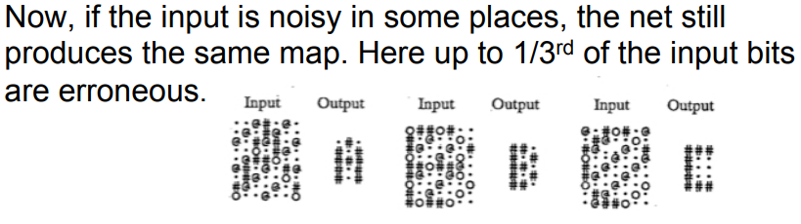

It is an example of Autoassociation/Hetroassociation

Slide 37
A:: An English-to-Spanish translation system mapping English words to Spanish words.
B:: Spelling corrector maps possibly incorrect spelt words to correctly spelt words in the same language
A and B are examples of what kind of Associations ???
Heto-Association,
Auto Association

Slide 38
SUPERVISED HEBB
[ Weights are strengthened by desired response for HETRO associative]

Slide 39
Two different ways for calculating weight matrix are used:
Iterative Method using Hebb Rule
The outer products.
New input vectors which can be similar and not similar to training input vectors are tested.
A new input vector differing from the training input vector in fewer components should produce the reasonable response as the same output vector

Slide 40
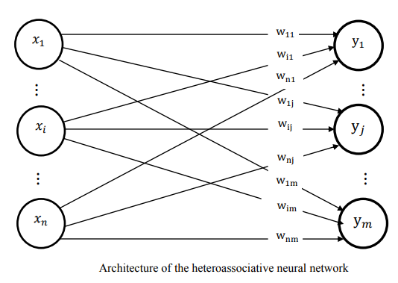

Slide 41
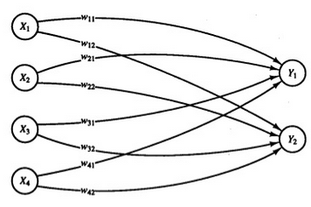
SUPERVISED HEBB[ Weights are strengthened by desired response)
A HETRO-ASSOCIATIVE net is to be trained to store the following mappings from input row vectors
s =( s₁ , s₂, s₃, s₄ ) to output row vectors t = ( t₁ , t₂)
For s ₁ = ( 1, 0,0,0) t =(1,0) For s ₂ =( 1, 1,0,0) t= (1,0)
For s ₃ = ( 0, 0,0,1) t= (0,1) For s ₄ =( 0, 0,1,1) t= (0,1)
WRITE WEIGHT MATRIX

Slide 42
Initial Weight matrix is ZERO in Hebb learning, iterative method
USING HEBB RULE KEEP UPDATING WEIGHT MATRIX TILL IT STORES ALL ASSOCIATIONS CORRECTLY

Slide 43
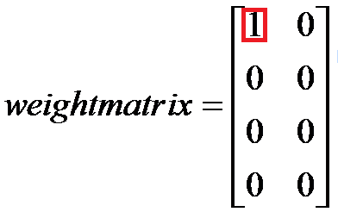
For s ₁ = ( 1, 0,0,0) t =(1,0) For s ₂ =( 1, 1,0,0) t= (1,0)
For s ₃ = ( 0, 0,0,1) t= (0,1) For s ₄ =( 0, 0,1,1) t= (0,1)
Step 0 : Initialize all weights to 0
Step 1 : For the First s:t pair (1,0,0,0) (1,0)
Step 2: x₁ =1, x₂ = x₃ =x₄ =0
Step 3 : y₁ =1; y₂ = 0
x₁ has affected only y₁ so only w₁₁ would change
Step 4: w₁₁ (new) = w₁₁ (old) + x₁ y₁ = 0+1=1
(All other weights remain unchanged at 0)

Slide 44
Step 1 : For the Second s:t pair (1,1,0,0): (1,0)
Step 2: x₁ =1, x₂ =1, x₃ =x₄ =0
Step 3 : y₁ =1; y₂ = 0
x₁ and x₂ have affected only y₁ so only w₁₁ and w₂₁ would change
Step 4: w₁₁ (new) = w₁₁ (old) + x₁ y₁ = 1+1=2
w₂₁ (new) = w₂₁ (old) + x₂ y₁ = 0+1=1

Slide 45
Step 1 : For the Third s:t pair (0,0,0,1): (0,1)
Step 2: x₁ = x₂ = x₃ =0, x₄ =1
Step 3 : y₁ =0; y₂ =1
x₄ has affected only y₂ so only w₄₂ would change
Step 4: w₄₂ (new) = w₄₂ (old) + x₄ y₂ = 0 + 1 = 1
(All other weights remain unchanged)

Slide 46
Step 1 : For the Fourth s:t pair (0,0,1,1): (0,1)
Step 2: x₁ = x₂ =0, x₃ = x₄ =1
Step 3 : y₁ =0; y₂ =1
x₃ and x₄ have affected only y₂ so only w₃₂ and w₄₂ would change
Step 4: w₃₂ (new) = w₃₂ (old) + x₃ y₂ = 0+1=1
w₄₂ (new) = w₄₂ (old) + x₄y₂ = 1+1=2
(All other weights remain unchanged)

Slide 47
OUTER PRODUCT METHOD

Slide 48
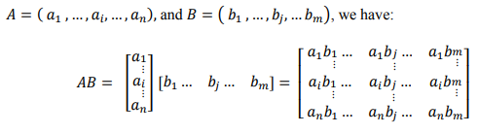
Mostly the weights of a net are computed from the training set by using the outer product instead of iterative updating of weights used in algorithm for Hebb rule.
A=(a₁,…a_{i},….,a_{n}) training vector
B = ( b₁,….b_{j},….b_{m} ) target vector
A is represented as nx1 column matrix,
B is represented as 1xm row matrix

Slide 49
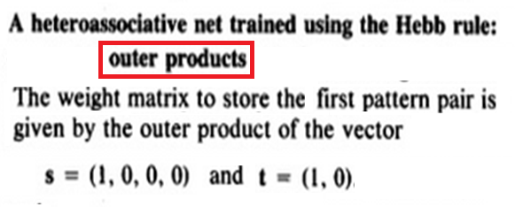
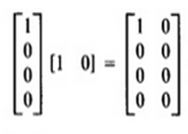

Slide 50
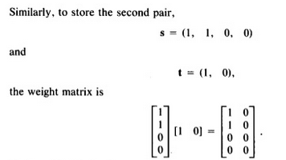
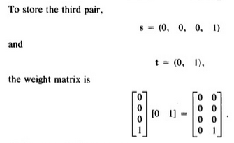

Slide 51
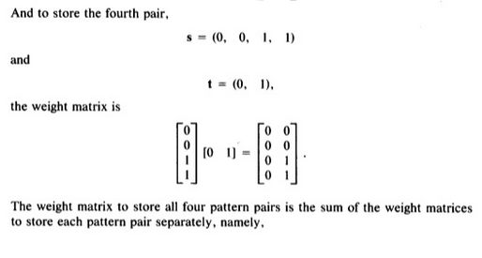


Slide 52
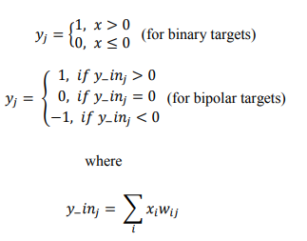

Slide 53
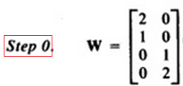
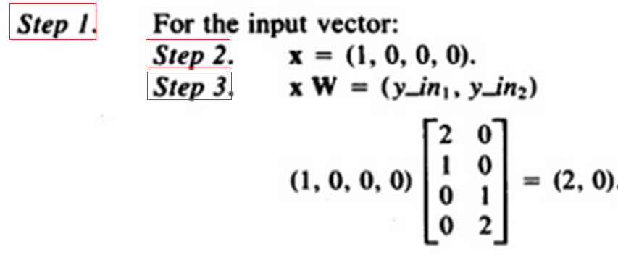
For s ₁ ( 1, 0,0,0) t₁ (1,0) For s ₂ ( 1, 1,0,0) t₂ (1,0)
For s ₃ ( 0, 0,0,1) t₃ (0,1) For s ₄ ( 0, 0,1,1) t₄ (0,1)

Slide 54
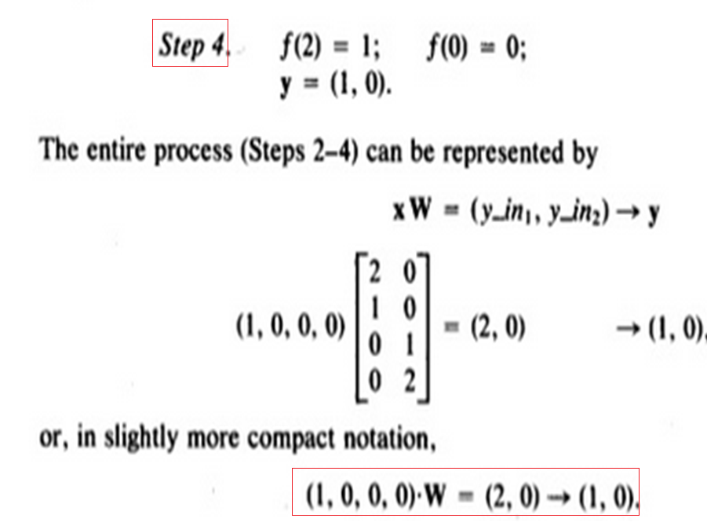
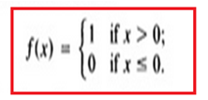

Slide 55
For s ₁ ( 1, 0,0,0) t (1,0) For s ₂ ( 1, 1,0,0) t (1,0)
For s ₃ ( 0, 0,0,1) t (0,1) For s ₄ ( 0, 0,1,1) t (0,1)

Slide 56
For s ₁ ( 1, 0,0,0) t (1,0) For s ₂ ( 1, 1,0,0) t (1,0)
For s ₃ ( 0, 0,0,1) t (0,1) For s ₄ ( 0, 0,1,1) t (0,1)
Testing a Hetro-associative network with input similar to training input
Test vector x =(0,1,0,0) differs from training vector s=(1,1,0,0) in the first component
(0,1,0,0).W = (1,0) -> (1,0)
Thus the net associates a known output pattern with this corrupted input

Slide 57
For s ₁ ( 1, 0,0,0) t (1,0) For s ₂ ( 1, 1,0,0) t (1,0)
For s ₃ ( 0, 0,0,1) t (0,1) For s ₄ ( 0, 0,1,1) t (0,1)
Test pattern (0,1,1,0) differs from each of training input patterns in atleast two components
(0,1,1,0).W=(1,1)->(1,1)
Output is not one of the outputs with which net was trained

Slide 58

store two associations, A1:B1 and A2:B2. in bipolar forms
A1 = (1, 0, 1, 0, 1, 0), B1 = (1, 1, 0, 0)
A2 = (1, 1, 1, 0, 0, 0), B2 = (1, 0, 1, 0)
These are then transformed into the bipolar forms:
X1 = (1, -1, 1, -1, 1, -1), Y1 = (1, 1, -1, -1)
X2 = (1, 1, 1, -1, -1, -1), Y2 = (1, -1, 1, -1)

Slide 59
Recall
To retrieve the association A1 = (1, 0, 1, 0, 1, 0), multiply it by W to get (4, 2, -2, -4), which, when run through a threshold, yields (1, 1, 0, 0), which is B1.
To find the reverse association, multiply B1 = (1, 1, 0, 0) by the transpose of W, find ??
[ 2 -2 2 -2 2 -2 ] ---.> ( 1 0 1 0 1 0)

Slide 60
AUTOASSOCIATIVE NET
For an auto associative net, the training input and target output are identical
Process of training is often called STORING the vectors, may be binary or bipolar
[Storage Phase]
A stored vector can be retrieved from distorted or partial (noisy) input, if input is sufficiently similar to it.[Recall Phase]

Slide 61
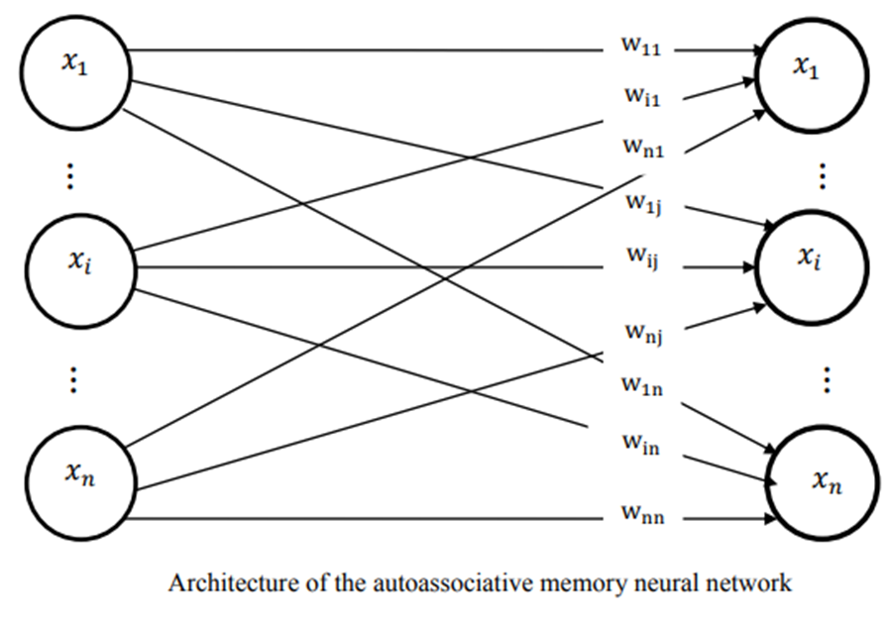

Slide 62
AUTOASSOCIATIVE NET
The performance of net is judged by its ability to reproduce a stored pattern from noisy input
Performance in general is better for bipolar vectors
In general for auto associative nets the weights on diagonal ( those which would connect an input pattern component to corresponding component in the output pattern) set to zero give better results
Setting these weights to zero may improve the net's ability to generalize(when more than one vector is stored in it).

Slide 63
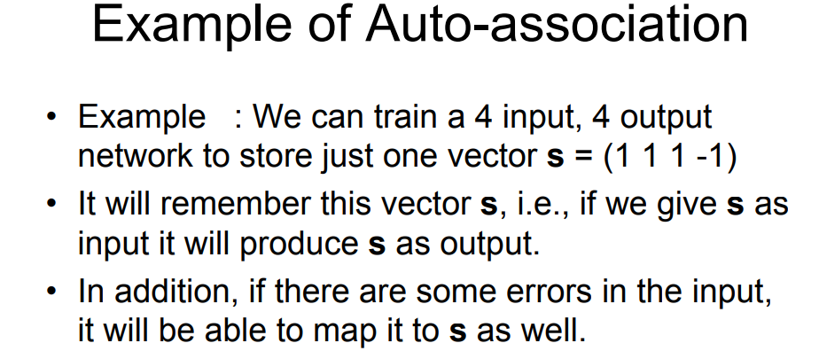
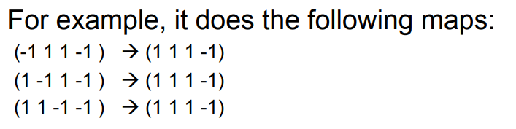

Slide 64
An Associative net to store one vector : recognizing the stored vector
Storing one pattern in auto associative net and then recalling, or recognizing that stored pattern
Vector s = ( 1,1,1,-1) is stored with weight matrix
Diagonal elements not zero
Bipolar activation function with threshold as zero

Slide 65
Associative network can recognize as ”known “ vectors that are similar to stored vectors, but differ slightly from it.
Differences could be two forms:
MISTAKES
MISSING data

Slide 66
Binary representation of inputs and targets (0 and 1 levels)
Missing Data: Cannot be represented.
Mistaken Data: A mistake of 1 is represented as 0 and vise versa.
Bipolar representation of inputs and targets (-1 and 1 levels)
Missing Data: this is represented by a 0.
Mistaken Data: A mistake in +1 is represented as -1 and vise versa.
In general a net can handle more missing components than mistaken/wrong components.

Slide 67
Testing an Autoassociative network with one mistake in (1,1,1,-1)
(1,1,1,-1) ➔ (-1,1,1,-1).W=(2,2,2,-2) ➔ (1,1,1,-1)
(1,1,1,-1) ➔ (1,-1,1,-1).W=(2,2,2,-2) ➔ (1,1,1,-1)
(1,1,1,-1) ➔ (1,1,-1,-1).W=(2,2,2,-2) ➔ (1,1,1,-1)
(1,1,1,-1) ➔ (1,1,1,1).W=(2,2,2,-2) ➔ (1,1,1,-1)
Testing an Autoassociative network with two mistakes in (1,1,1,-1)
(1,1,1,-1) ➔ (-1,-1,1,-1).W=(0,0,0,0) ➔ (1,1,1,1)
Does not recognize

Slide 68
Testing an Autoassociative Network with two “missing“ entries in input vector
(1,1,1,-1) ➔ (0,0,1,-1).W=(2,2,2,-2) ➔ (1,1,1,-1)
(1,1,1,-1) ➔ (0,1,0,-1).W=(2,2,2,-2) ➔ (1,1,1,-1)
(1,1,1,-1) ➔ (0,1,1,0).W=(2,2,2,-2) ➔ (1,1,1,-1)
(1,1,1,-1) ➔ (1,0,0,-1).W=(2,2,2,-2) ➔ (1,1,1,-1)
(1,1,1,-1) ➔ (1,0,1,0).W=(2,2,2,-2) ➔ (1,1,1,-1)
(1,1,1,-1) ➔ (1,1,0,0).W=(2,2,2,-2) ➔ (1,1,1,-1)

Slide 69
AN AUTOASSOCIATIVE NETWORK WITH NO SELF-CONNECTIONS :ZEROING OUT DIAGONAL
Testing an Autoassociative network with two mistakes in (1,1,1,-1)
(1,1,1,-1) ➔ (-1,-1,1,-1).W₀=(1,1,1,1) ➔ (1,1,1,1)
Still does not recognize

Slide 70
(1,1,1,-1)- Stored Vector Two Missing Data
(1,1,1,-1) ➔ (0,0,1,-1).W₀ =(2,2,1,-1) ➔ (1,1,1,-1)
(1,1,1,-1) ➔ (0,1,0,-1).W₀=(2,1,2,-1) ➔ (1,1,1,-1)
(1,1,1,-1) ➔ (0,1,1,0).W₀ =(2,1,1,-2) ➔ (1,1,1,-1)
(1,1,1,-1) ➔ (1,0,0,-1).W₀=(1,2,2,-1) ➔ (1,1,1,-1)
(1,1,1,-1) ➔ (1,0,1,0).W₀=(1,2,1,-2) ➔ (1,1,1,-1)
(1,1,1,-1) ➔ (1,1,0,0).W₀=(1,1,2,-2) ➔ (1,1,1,-1)

Slide 71
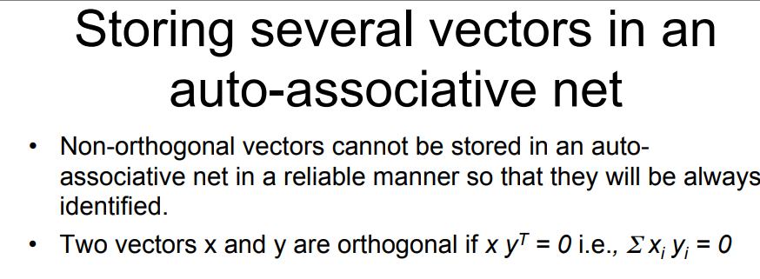

Slide 72
Example: Storing 2 vectors in an auto-associative net
• More than one vector can be stored in an auto-associative net by simply adding the weights needed for each vector.
• store (1 1 -1 -1) and (-1 1 1 -1) [orthogonal] in an auto-associative net.
• We obtain the weight matrices for each input and add them up.

Slide 73
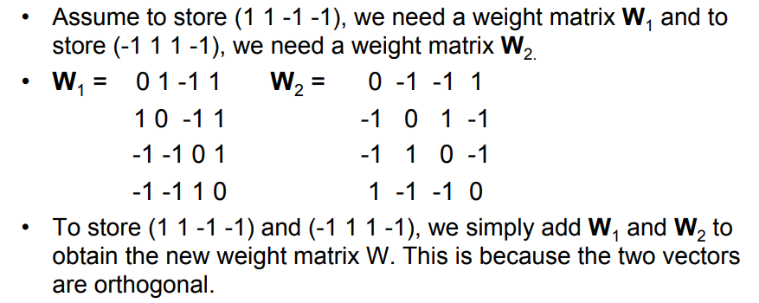
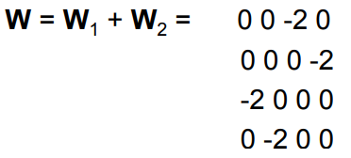

Slide 74
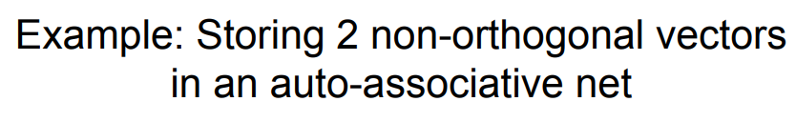
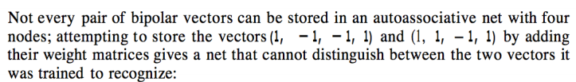
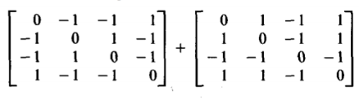
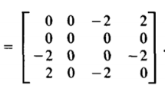

Slide 75
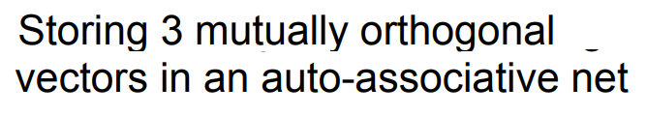

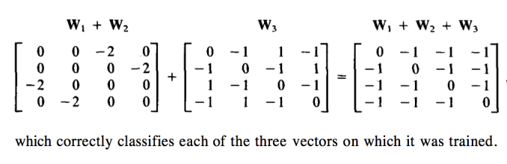

Slide 76
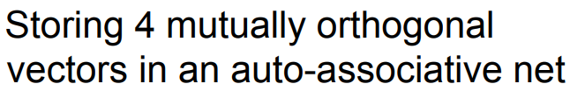
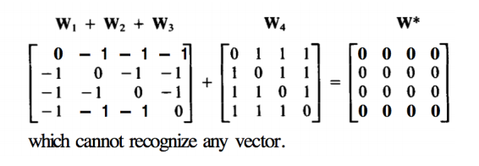

Slide 77
END

